Slide 1
IPRO 497-109
WK 5 2-11-20
Digital Service Design

Slide 2
ANNOUNCEMENTS
BUILD WEEK
Safety Training should be completed—who has not?
Expectations on enrichments individual submissions
Quick OS Review (TAs)

Slide 3

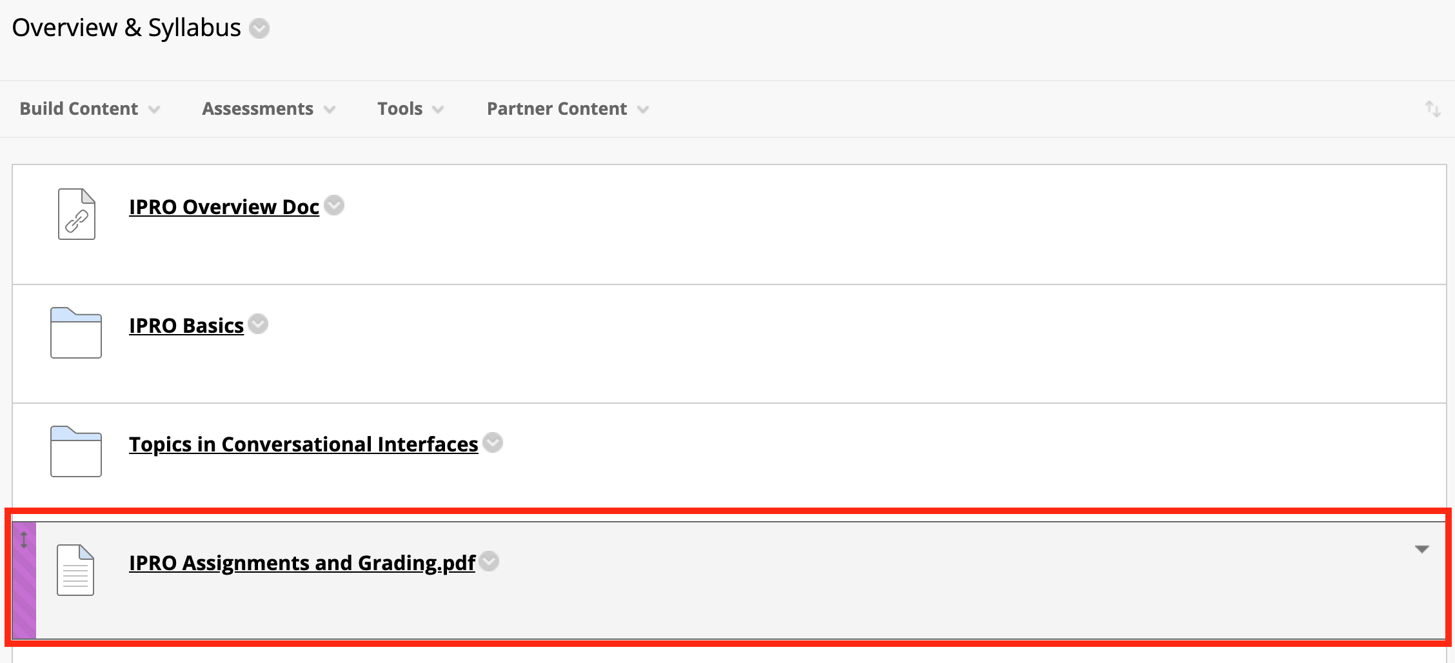
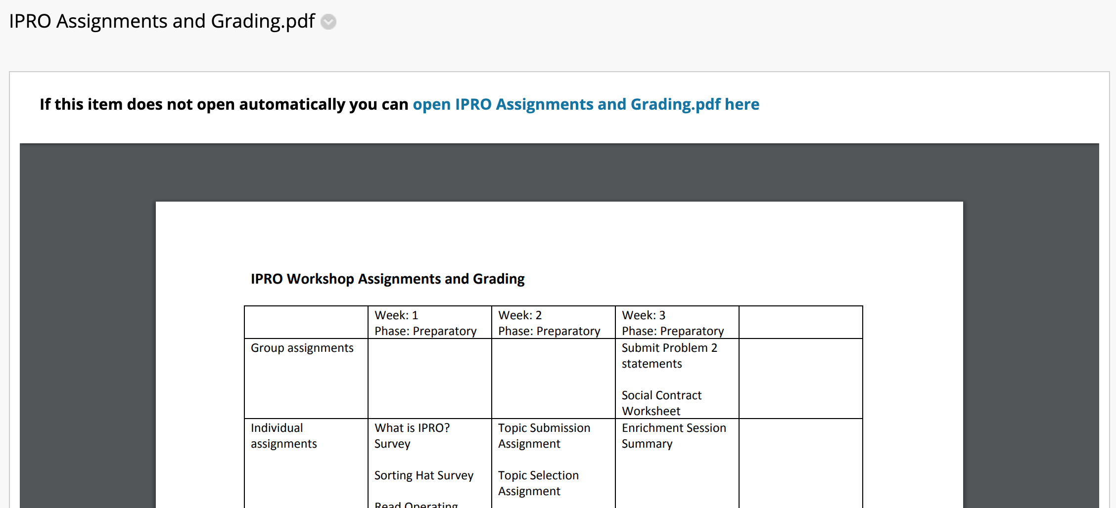
OS Review
BUILD WEEK
Enrichment Feedback
We will be using a Google Doc moving forward for reflections.
Write 2 paragraphs; one focused on learnings and the other on how you might implement into other areas.
Do no copy slides as we will be reading and providing feedback on reflections.

Slide 4
Enrichment Feedback
BUILD WEEK
We will be using a Google Doc moving forward for reflections.
Write 2 paragraphs; one focused on learnings and the other on how you might implement into other areas on campus and in life.
Do no copy slides as we will be reading and providing feedback on reflections.

Slide 5
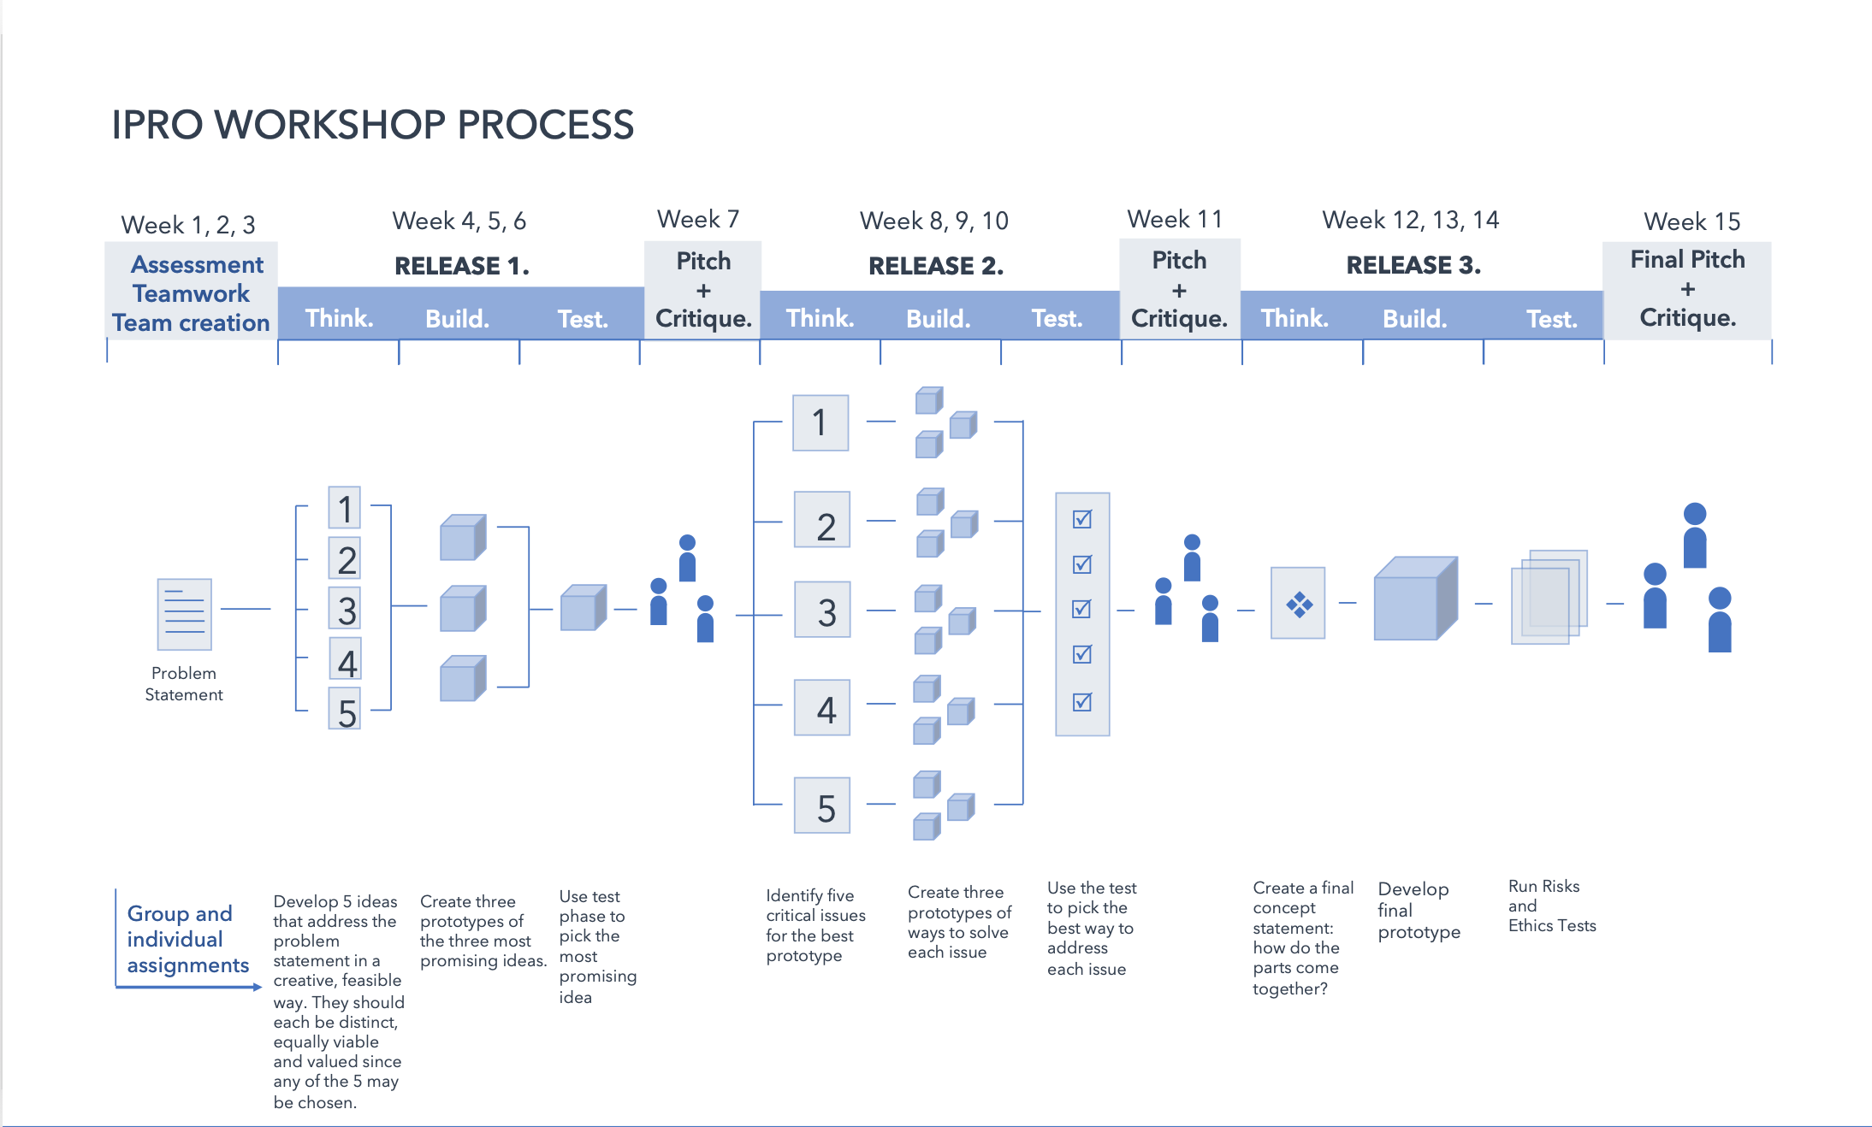

Slide 6
KEY LEARNINGS
BUILD WEEK
How to use rough, quick, and cheap prototypes to help us develop ideas
Making things tangible, even in a rough way, helps to make our ideas
more complete and robust
We can then use these prototypes to test our ideas, helping us understand what works and what does not.

Slide 7
AGENDA
BUILD WEEK
6:45-7pm Short lecture, “Frankin” (low-fidelity) prototypes
7-7:30pm Team activities, pick top 3 ideas from the 5 submitted Please note: teams can not proceed to next step of prototyping until a professor has reviewed this
7:30-9pm Plan and build prototypes for each idea (using testing card)
Notes:
In class
● Review social contract data
● Review and grade enrichment session submissions
● Grade idea submissions
● Ensure students get training in idea shop
• Meet with each team. Help them use the testing card to develop
their prototypes
● Review attendance

Slide 8
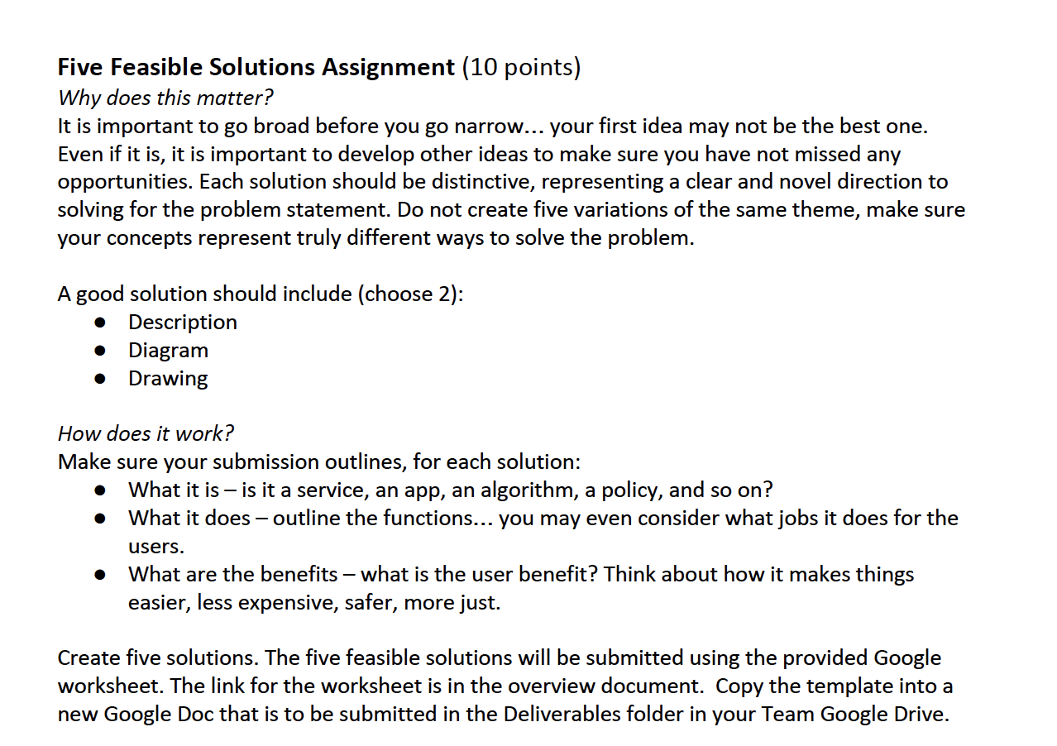
A Strategy to Evaluate Your Ideas
BUILD WEEK
Last week’s assignment
Concept Name | Need 1 (e.g. > efficiency) | Need 2 (e.g. > navigation) | Need 3 (e.g. > safety) | Total
Idea 1 | 1 | 2 | 2 | 5
Idea 2 | 3 | 3 | 3 | 9
Idea 3 | 1 | 1 | 1 | 3
Idea 4 | 0 | 0 | 1 | 1
Idea 5 | 3 | 3 | 2 | 8
Score card
Unlikely = 0
Possible = 1
Likely = 2
Highly likely = 3
Notes:
In class
● Review social contract data
● Review and grade enrichment session submissions
● Grade idea submissions
● Ensure students get training in idea shop
• Meet with each team. Help them use the testing card to develop
their prototypes
● Review attendance

Slide 9
Effective Prototypes
BUILD WEEK
Effective prototypes
Are experiences, not explanations
Are simple; they test core functions and features
Are not precious; feedback is most important
Notes:
In class
● Review social contract data
● Review and grade enrichment session submissions
● Grade idea submissions
● Ensure students get training in idea shop
• Meet with each team. Help them use the testing card to develop
their prototypes
● Review attendance

Slide 10
Prototype Development Protocol
BUILD WEEK
Step 1 - Develop clear description of your concept
Step 2 - Articulate hypothesis of what your concept will achieve
(i.e., how will behavior, efficiency, safety and/or justice change?)
Step 3 - Explain the test you will run with prototype
(i.e., What will you measure and observe? How will you know if you are successful?)
Step 4 - Identify materials needed to build and test the prototype.
Notes:
In class
● Review social contract data
● Review and grade enrichment session submissions
● Grade idea submissions
● Ensure students get training in idea shop
• Meet with each team. Help them use the testing card to develop
their prototypes
● Review attendance

Slide 11
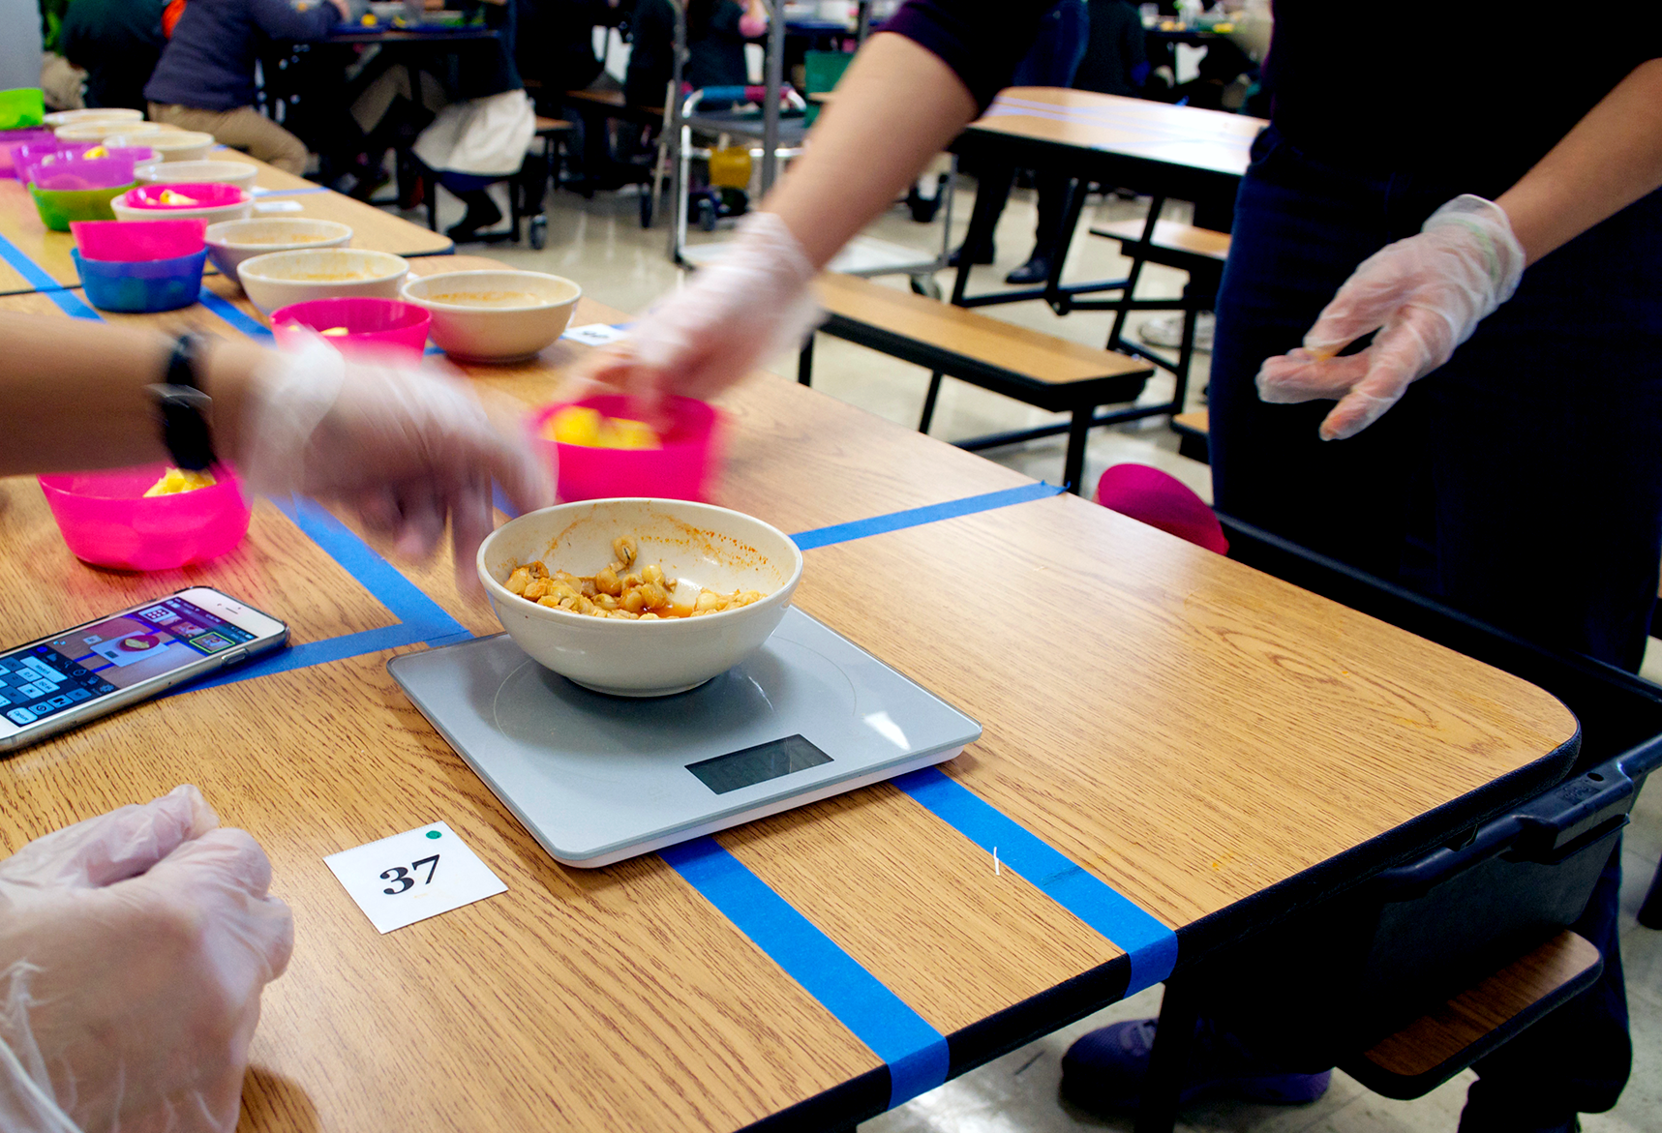
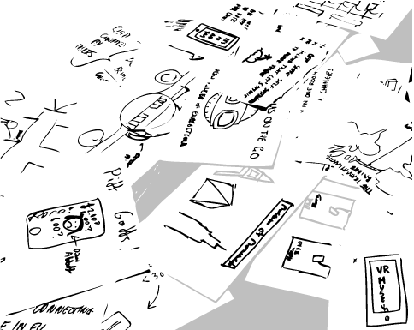
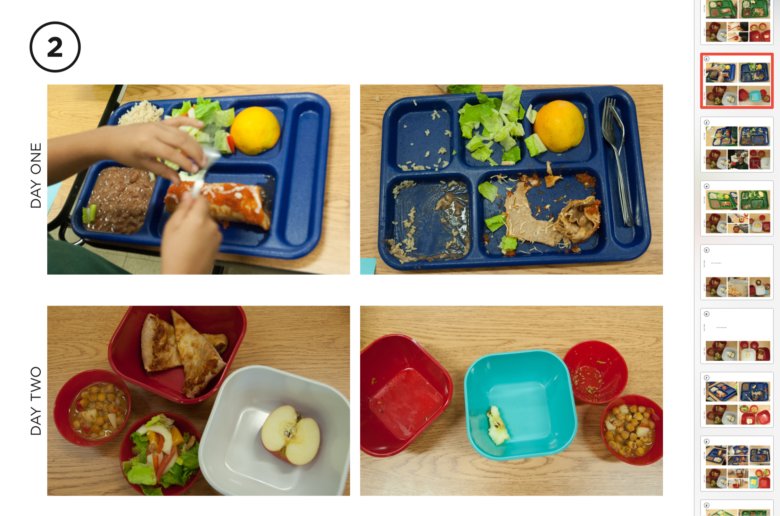
Prototype Methods
BUILD WEEK
What should this look like?
How will this work?
Will people fit into this particular prototype?
Who will use this?
What features will it have?
What Must Be True...
For us to feel comfortable investing more time and money into this concept?
Service Prototype
Sketch/ paper prototype
Notes:
In class
● Review social contract data
● Review and grade enrichment session submissions
● Grade idea submissions
● Ensure students get training in idea shop
• Meet with each team. Help them use the testing card to develop
their prototypes
● Review attendance

Slide 12
Assignment
BUILD WEEK
3 Prototypes - Team assignment
Create 3 prototypes by methodically using the development protocol.
Upload document (1 prototype per page; development protocol summary and picture) to team deliverable folder on google drive
Social Contract - Individual assignment
Notes:
In class
● Review social contract data
● Review and grade enrichment session submissions
● Grade idea submissions
● Ensure students get training in idea shop
• Meet with each team. Help them use the testing card to develop
their prototypes
● Review attendance

